Slide 1
Review of Feedback Control System

Slide 2
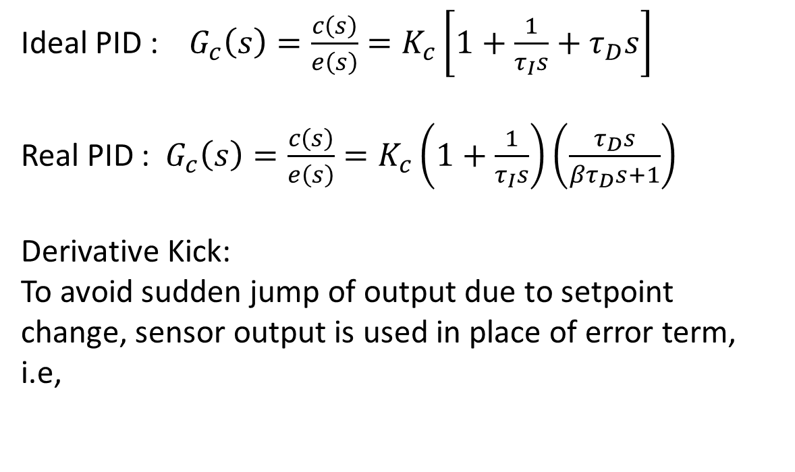
Transfer Function for a PID Controller
Ideal PID : $G_{c}\left(s\right)=\frac{c\left(s\right)}{e\left(s\right)}=K_{c}\left[1+\frac{1}{τ_{I}s}+τ_{D}s\right]$
Real PID : $G_{c}\left(s\right)=\frac{c\left(s\right)}{e\left(s\right)}=K_{c}\left(1+\frac{1}{τ_{I}s}\right)\left(\frac{τ_{D}s}{βτ_{D}s+1}\right)$
Derivative Kick:
To avoid sudden jump of output due to setpoint change, sensor output is used in place of error term, i.e,

Slide 3
Direct / Reverse acting controller
What will be the sign of the controller gain?

Slide 4
Guidelines for Selecting Direct and Reverse Acting PID’s
Consider a direct acting final control element to be positive and reverse to be negative.
If the sign of the product of the final control element and the process gain is positive, use the reverse acting PID algorithm.
If the sign of the product is negative, use the direct acting PID algorithm
If control signal goes to a control valve with a valve positioner, the actuator is considered direct acting.

Slide 5
Level Control Example
Process gain is positive because when flow in is increased, the level increases.
If the final control element is direct acting, use reverse acting PID.
For reverse acting final control element, use direct acting PID.

Slide 6
Level Control Example
Process gain is negative because when flow out is increased, the level decreases.
If the final control element is direct acting, use direct acting PID.
For reverse acting final control element, use reverse acting PID.

Slide 7
General Feedback Control Loop
d(s)
G_{d}(s)
y_{sp}(s)
e(s)
c(s)
u(s)
G_{P}(s)
+
y(s)
K_{S}
-
G_{C}(s)
G_{a}(s)
+
+
y_{S}(s)
G_{S}(s)
Characteristic Polynomial : 1 + G_{OL} = 0 or $1+G_{c}\left(s\right)G\left(s\right)=0$

Slide 8
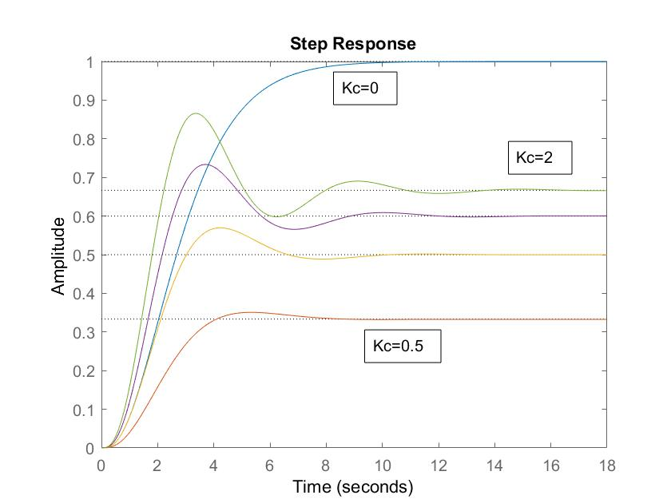

Controller actions on feedback dynamics
Process G(s) : $\frac{1}{{\left(s+1\right)}^{3}}$ Controller : Proportional, $K_{c}$;
Matlab:
s=tf(‘s’); g=1/(s+1)^3;
step(g); hold on
for kc=[0.5:0.5:2],
gcl=feedback(kc*g,1);
step(gcl);
end

Slide 9
Proportional Control
Important points:
proportional feedback does not change the order of the system
started with a first order process
closed-loop process also first order
order of characteristic polynomial is invariant under proportional feedback
speed of response of closed-loop process is directly affected by controller gain
increasing controller gain reduces the closed-loop time constant
In general, proportional feedback
reduces (does not eliminate) offset
speeds up response
for oscillatory processes, makes closed-loop process more oscillatory

Slide 10
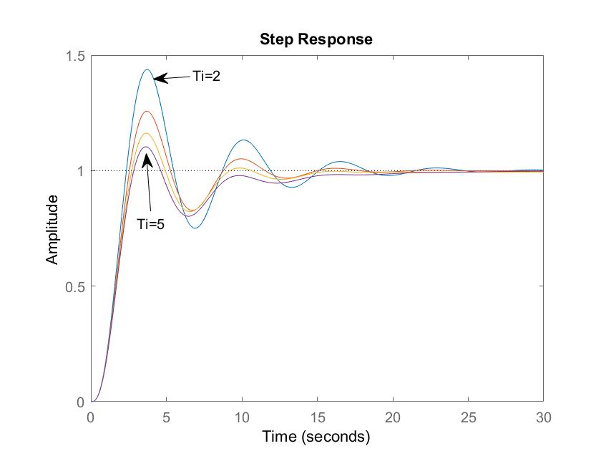

Controller actions on feedback dynamics
Process G(s) : $\frac{1}{{\left(s+1\right)}^{3}}$ Controller : PI (I varying) $K_{c}(1+\frac{1}{τs})$;
Matlab:
figure; hold on; kc=2;
for Ti=[2:1:5],
gc=tf(kc*[1,1/Ti],[1,0]);
gcl=feedback(gc*g,1);
step(gcl);
end

Slide 11
Proporional - Integral Control
Important points:
integral action increases order of the system in closed-loop
integral action eliminates offset
integral action
should be small compared to proportional action
tuned to slowly eliminate offset
can increase or cause oscillation
can be de-stabilizing
PI controller has two tuning parameters that can independently affect
speed of response
Nature of response (oscillation)
PI is the most widely used controller in industry
optimal structure for first order processes

Slide 12
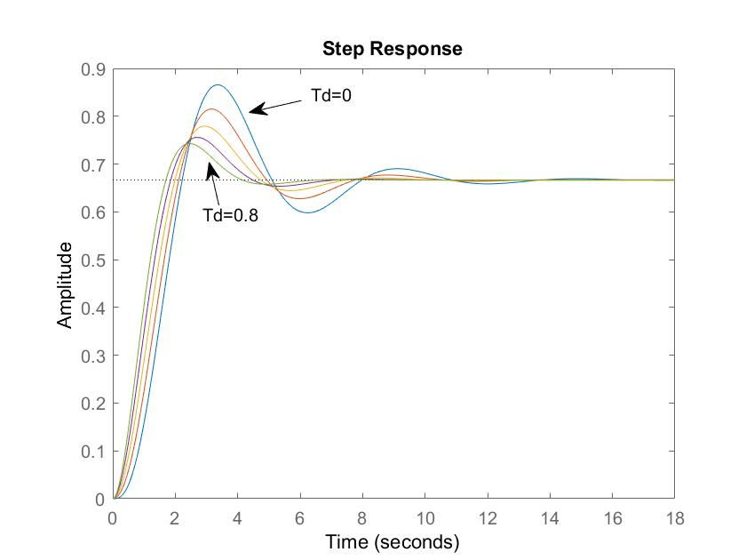

Controller actions on feedback dynamics
Process G(s) : $\frac{1}{{\left(s+1\right)}^{3}}$ Controller : PD, $K_{c}(1+τ_{D}s)$;
Matlab:
figure; hold on; kc=2;
for Td=[0:0.2:0.8],
gc=tf(kc*[Td,1],[1]);
gcl=feedback(gc*g,1);
step(gcl); end

Slide 13
Proportional Derivative
Important Points:
derivative action does not increase the order of the system
Used to compensate for trends in output
measure of speed of error signal change
provides predictive or anticipatory action
adding derivative action affects the period of oscillation of the process
good for disturbance rejection
poor for tracking
derivative action
should be small compared to integral action
has a stabilizing influence
difficult to use for noisy signals
usually modified in practical implementation

Slide 14
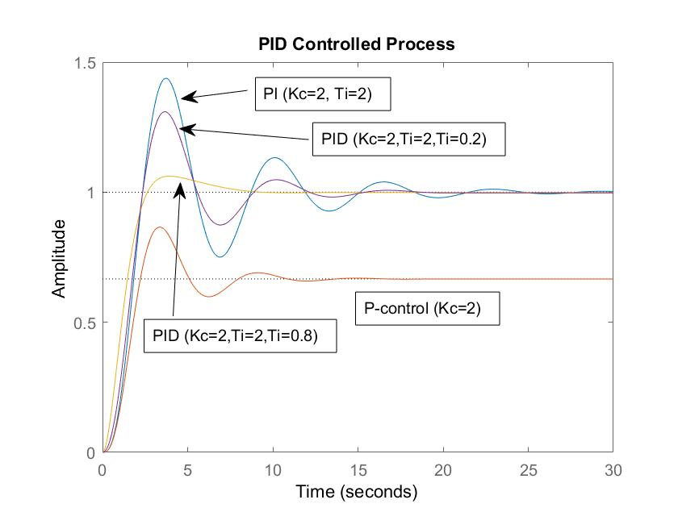
PID control (Setpoint Tracking or Servo Control)

Slide 15
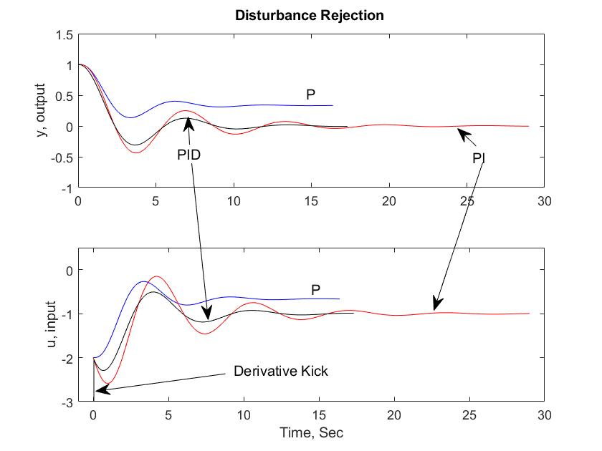
Disturbance Rejection: Input dynamics

Slide 16
Closed-loop Stability
Every control problem involves a consideration of closed-loop stability
General concepts:
BIBO Stability:
“ An (unconstrained) linear system is said to be stable if the output response is bounded for all bounded inputs. Otherwise it is unstable.”
Comments:
Stability is much easier to prove than instability
This is just one type of stability

Slide 17
Closed-loop Stability
General Stability criterion:
“ A closed-loop feedback control system is stable if and only if all roots of the characteristic polynomial (1+ G_{OL}=0) are negative or have negative real parts. Otherwise, the system is unstable.”
Unstable region is the right half plane of the complex plane.
Valid for any linear systems.
Underlying system is almost always nonlinear so stability holds only locally. Moving away from the point of linearization may cause instability

Slide 18
Stability Analysis Methods
Problem reduces to finding roots of a polynomial
Traditional:
1. Routh array:
Test for positivity of roots of a polynomial
2. Direct substitution
Complex axis separates stable and unstable regions
Find controller gain that yields purely complex roots
3. Root locus diagram
Vary location of poles as controller gain is varied
Of limited use
Bode stability criteria
Niquist Stability criteria

Slide 19
Closed-loop stability
Routh array for a polynomial equation
is
where
Elements of left column must be positive to have roots with negative real parts

Slide 20
Example: Routh Array
Characteristic polynomial
Polynomial Coefficients
Routh Array
Closed-loop system is unstable
1
2
3
4
5
6

Slide 21
Direct Substitution
Technique to find gain value that de-stabilizes the system.
Observation:
Process becomes unstable when poles appear on right half plane
Find value of K_{c} that yields purely complex poles
Strategy:
Start with characteristic polynomial
Write characteristic equation:
Substitute for complex pole (s=jω)
Solve for K_{c} and ω

Slide 22
Example: Direct Substitution
Characteristic equation
Substitution for s=jω
Real Part : Complex Part:
System is unstable if

Slide 23
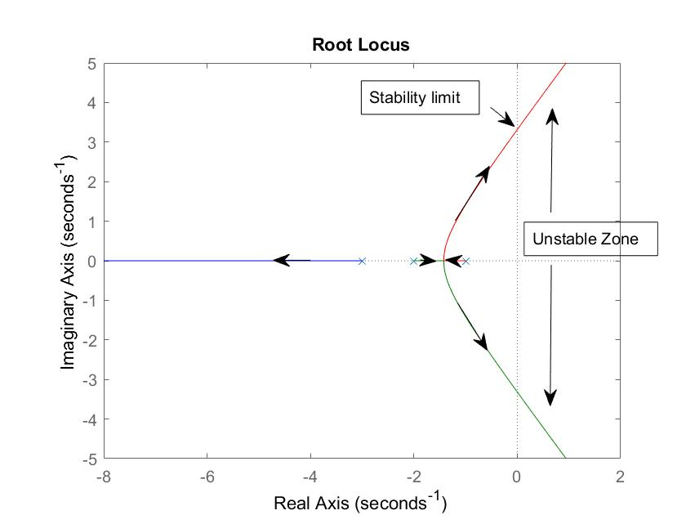
Root Locus Diagram
Old method that consists in plotting roots of characteristic polynomial (closed loop poles) as controller gain is changed.
Matlab
s=tf(‘s’);
G1=1/(s+1);
G2=1/(s+2);
G3=1/(s+3);
G=G1*G2*G3;
rlocus(G);
rlocfind(G);

Slide 24
Frequency Response
$$u=A sinωt$$
$$y=\hat{A }sin⁡(ωt+φ)$$
Process
Amplitude Ratio (AR) = Â/A
Phase lag ($φ)$ = -Δt/P*180
The process acts as a “filter” or “amplifier” that attenuates or amplifies the input at frequency $ω$.
The frequency response of a process G(s) at a specific frequency $ω$ is a complex number and can be obtained by substituting $s=jω$
P
Δt

Slide 25
Frequency Response
$G\left(jω\right)=Re\left(ω\right)+j Im\left(ω\right)=ρ\left(ω\right)e^{jφ(ω)}$
$ρ\left(ω\right)=AR=\sqrt{Re^{2}\left(ω\right)+Im^{2}(ω)}=\left|G(jω)\right|$
$φ=phase difference=arc\tan\left(\frac{Im\left(ω\right)}{Re\left(ω\right)}\right)=∠G(jω)$
Two ways of representing the frequency response
Bode Plot
Log-Log plot of AR vs $ω$ and semi-log plot $φ$ vs $ω$
Nyquist Plot
Plot of Re($ω$) vs Im($ω$) for various values of $ω$.
Frequency does not appear explicitly in this plot.

Slide 26
Bode Plot
Steady state gain:
$$K=ρ\left(0\right)e^{jφ(0)}$$
Bandwidth, $ω_{b}$, defines the highest frequency at which the process displays no attenuation. It is calculated based on the frequency when amplitude reaches 0.707 K.
Roll-off is slope of decaying AR at high frequencies.
Meeting pt of LFA and HFA

Slide 27
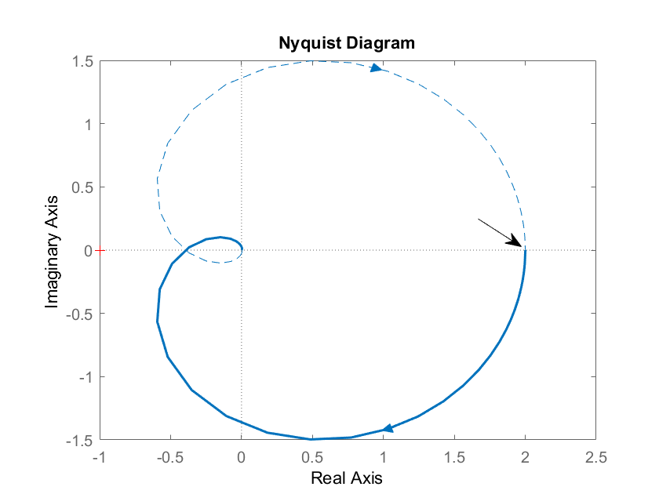
$$ω=0$$
$$φ(ω)$$
Crossover $ω$
AR($ω)$

Slide 28

Bode Stability Criterion
D(s)
Consider open-loop control system
1. Introduce sinusoidal input in setpoint (D(s)=0) and observe sinusoidal output
2. Fix gain such AR=1 and input frequency such that $φ$=-180
3. At same time, connect close the loop and set Y_{SP}(s)=0
Q: What happens if AR <1, 1 and >1?
Y_{SP}(s)
+
U(s)
+
Y(s)
G_{c}
G_{p}
-
+
G_{s}
Y_{s}(s)
Open-loop Response to Y_{SP}(s)

Slide 29
Bode Stability Criterion
A closed-loop system is unstable if the frequency of the response of the open-loop G_{OL} has an amplitude ratio greater than one at the critical frequency. Otherwise it is stable.
Strategy:
1. Solve for ω in
2. Calculate AR

Slide 30
Bode Stability Criterion
To check for stability:
1. Compute open-loop transfer function
2. Solve for ω in φ=-π
3. Evaluate AR at ω
4. If AR>1 then process is unstable
Find ultimate gain:
1. Compute open-loop transfer function without controller gain
2. Solve for ω in φ=-π
3. Evaluate AR at ω
4. Let

Slide 31
Bode Criterion
Consider the transfer function and controller
- Open-loop transfer function
- Amplitude ratio and phase shift
- At φ=-π, ω=1.4128, AR=6.746

Slide 32
Bode Stability
Phase Crossover frequency ($ω_{gc})$is the frequency at which phase lag is 180⁰.
Gain Crossover frequency ($ω_{pc}$) is the frequency at which AR = 1
Gain Margin (GM) is the amount of gain required for the AR to reach 1 at phase crossover frequency.
GM=1/AR_{C} , where AR_{C} is the Amplitude ratio at gain crossover frequency.
Phase Margin (PM) is the amount of phase difference required for phase lag to reach 180⁰ at gain crossover frequency. PM=180+$φ_{pc}$ where $φ_{pc}$ is phase lag at phase crossover frequency.

Slide 33
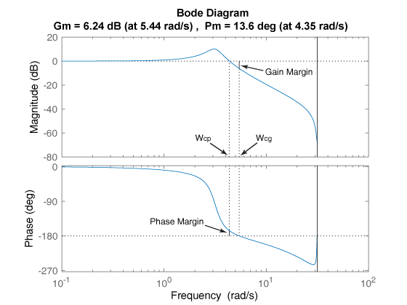
Gain Margin and Phase Margin
Wcg is the frequency where the gain margin is measured, which is a -180° phase crossing frequency.
Wcp is the frequency where the phase margin is measured, which is a 0-dB gain crossing frequency.
dB=20 log₁₀AR

Slide 34
Nyquist Stability Criterion
If N is the number of times that the Nyquist plot encircles the point (-1,0) in the complex plane in the clockwise direction, and P is the number of open-loop poles of G_{OL} that lie in the right-half plane, then Z=N+P is the number of unstable roots of the closed-loop characteristic equation.
Strategy
1. Substitute s=jω in G_{OL}(s)
2. Plot G_{OL}(jω) in the complex plane
3. Count encirclements of (-1,0) in the clockwise direction

Slide 35
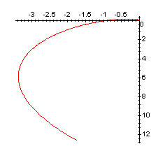
Nyquist Criterion
Consider the transfer function
and the P controller

